Slide 1
Machine Learning For Micro-Credit Loans
Submitted By
Promila

Slide 2
Data Set
Micro-credit loan defaulter data set.
•Source : Client provided dataset.
•Abstract :
Number of Instances (209593)
Attributes (Float, Interger, String)
Number Of Attributes (36) –
label,msisdn,aon,daily_decr30,daily_decr90,rental30,rental90,last_rech_date_ma,last_rech_date_da,last_rech_amt_ma,cnt_ma_rech30,fr_ma_rech30,sumamnt_ma_rech30,medianamnt_ma_rech30,medianmarechprebal30,cnt_ma_rech90,fr_ma_rech90,sumamnt_ma_rech90,medianamnt_ma_rech90,medianmarechprebal90,cnt_da_rech30,fr_da_rech30,cnt_da_rech90,fr_da_rech90,cnt_loans30,amnt_loans30,maxamnt_loans30,medianamnt_loans30,cnt_loans90,amnt_loans90,maxamnt_loans90,medianamnt_loans90,payback30,payback90,pcircle,pdate.

Slide 3
Problem Statement
This research aimed at the case of customers @ loan paid & loan not paid & compares predictive ability of loan payment among the different classification methods , the result of predictive accuracy of loan repayment will be more valuable than binary results of the classification – defaulter or not defaulter.
What to achieve : (1-Non Defaulter , 0-Defaulter)
Customers loan repayment financial capability.

Slide 4
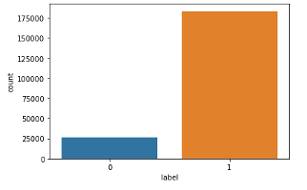
Data Exploration & Facts
•It shows defaulter as 26162 people & non-defaulter as 183431 out of total borrower 209,593.

Slide 5
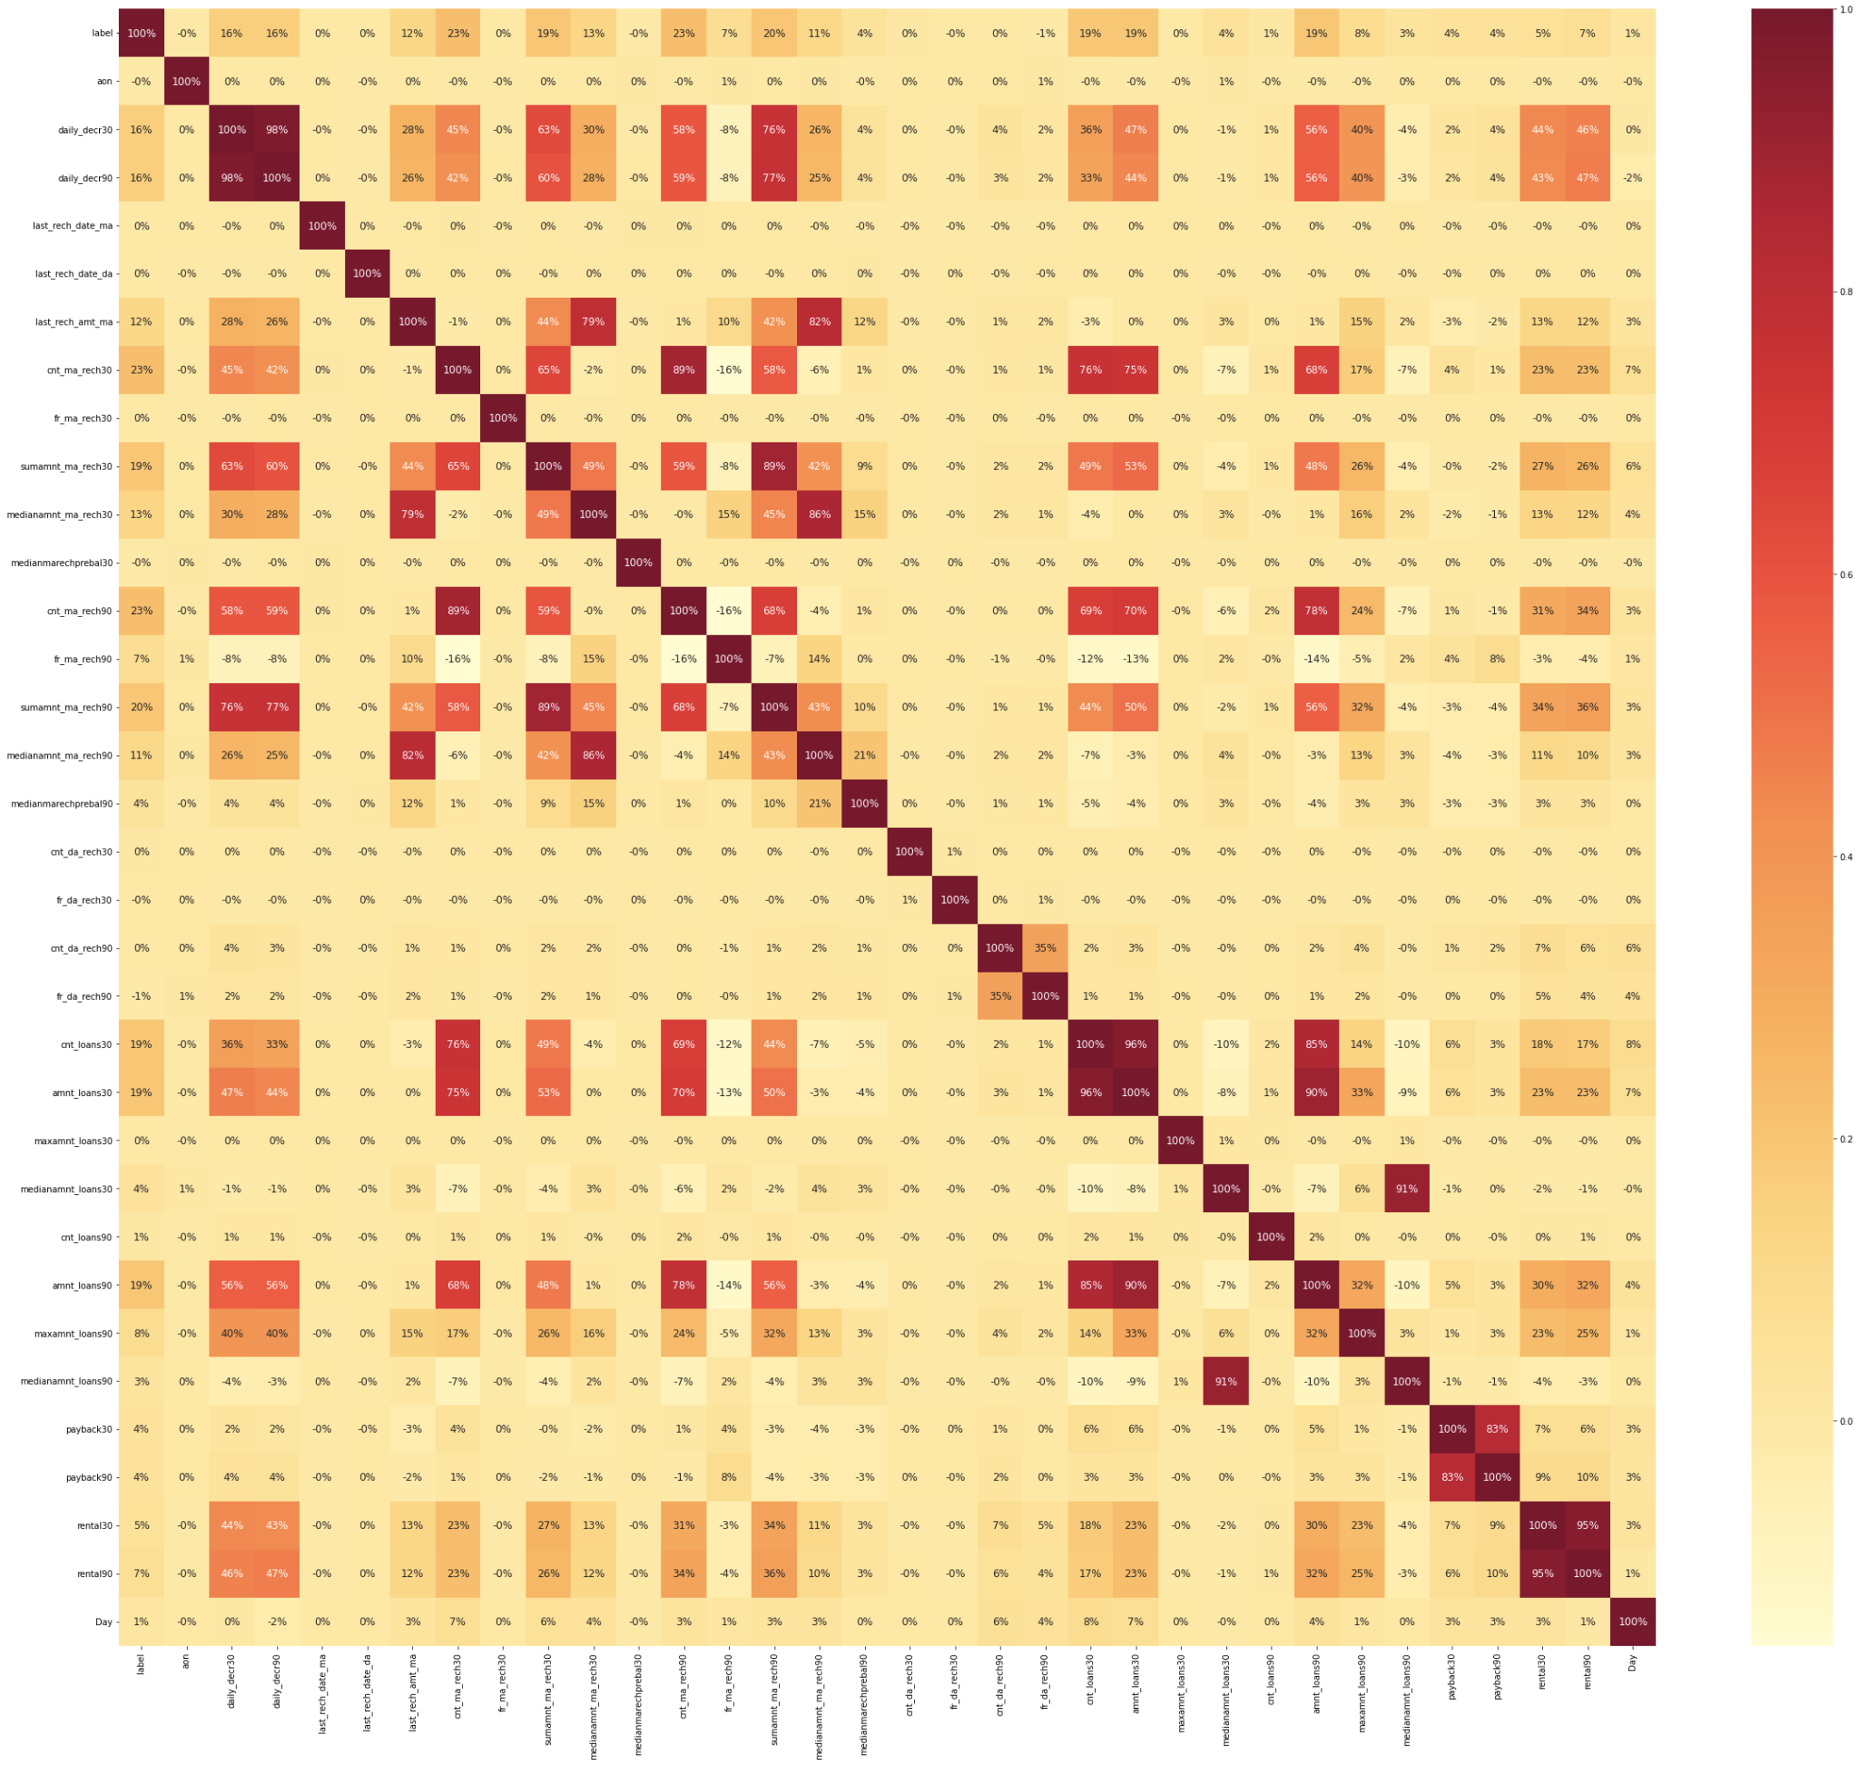
•Below plot shows mutual relation between attributes , correlation increases from light to dark color.
•Recommendations-
•Customer’s Loan repayment capability depends upon below –
•Customer spending Daily amount in last 30 days , spending average main account balance in last 30 days, Frequency of recharge for data account & main account in 30/90 days, loan taken in last 90 days & payback time for last 30 days.

Slide 6
Requirement of Machine Learning
•Will try to find out accurate prediction for defaulter & non-defaulter both.
•To achieve this result , will build classification model.

Slide 7
Supervised Learning methods
•Logistic Regression – Hyper parameters
•Decision Tree Classifier – Node Splitting on all available variables.
•Linear Discriminant Analysis – Works to estimate the probability that the data belongs to each target.
.Random Forest classifier-a meta estimator that fits a number of decision tree classifiers on various sub-samples of the dataset and uses averaging to improve the predictive accuracy and control over-fitting

Slide 8
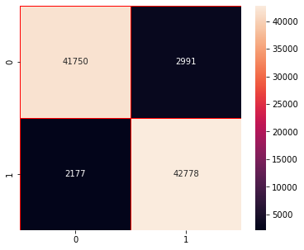
Random Forest Classifier
The accuracy score of train is : 99.98885123082411
The accuracy score test is : 94.23831608990368
The cross validation score is : 93.89270441481577
Confusion Matrix:
[[41750 2991]
[ 2177 42778]]
Classification
precision recall f1-score support
0 0.95 0.93 0.94 44741
1 0.93 0.95 0.94 44955
accuracy 0.94 89696
macro avg 0.94 0.94 0.94 89696
weighted avg 0.94 0.94 0.94 89696

Slide 9
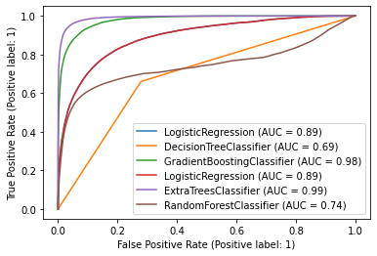
Plot roc curve
ROC CURVE

Slide 10
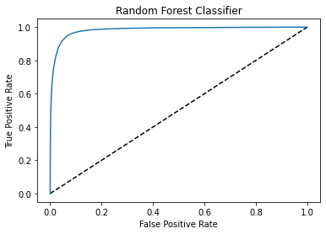
FPR,TPR
Random Forest Classifier

Slide 11
Thank You

